Slide 1
Cash Flow Statement
Farheen Qaiser
M.PHIL-23F-02
1st Semester

Slide 2

What is a Cash Flow Statement?
A cash flow statement is a financial statement that provides a detailed account of the inflows and outflows of cash within an organization over a specified period of time, typically a fiscal quarter or year. It presents a summary of how a company manages its cash position, offering insights into its liquidity and ability to meet its financial obligations.

Slide 3
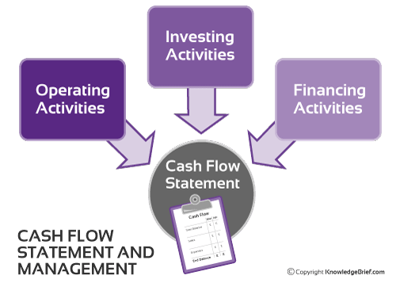
Classification of Cash Flow Statement:

Slide 4
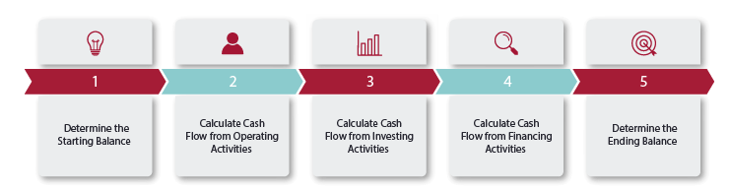
How to prepare a Cash Flow Statement?

Slide 5

How Cash Flow is calculated?

Slide 6
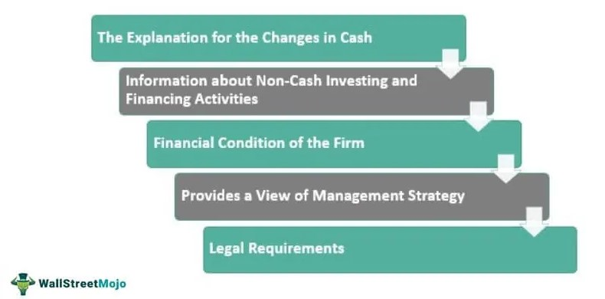
Purpose of a Cash Flow Statement:

Slide 7


